Slide 1


Slide 2
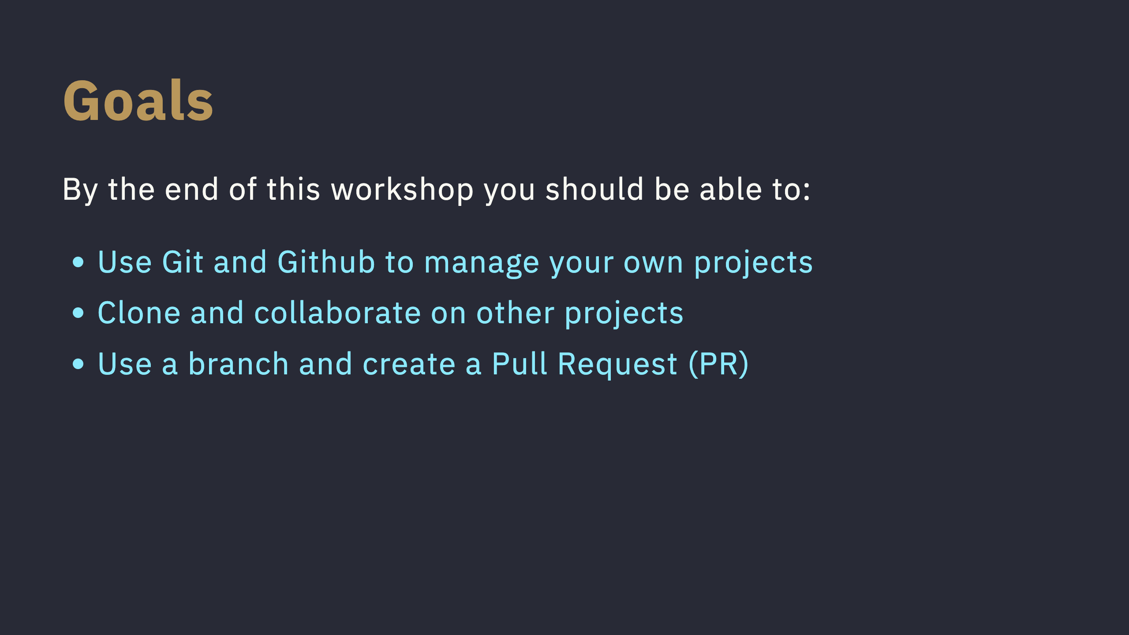

Slide 3
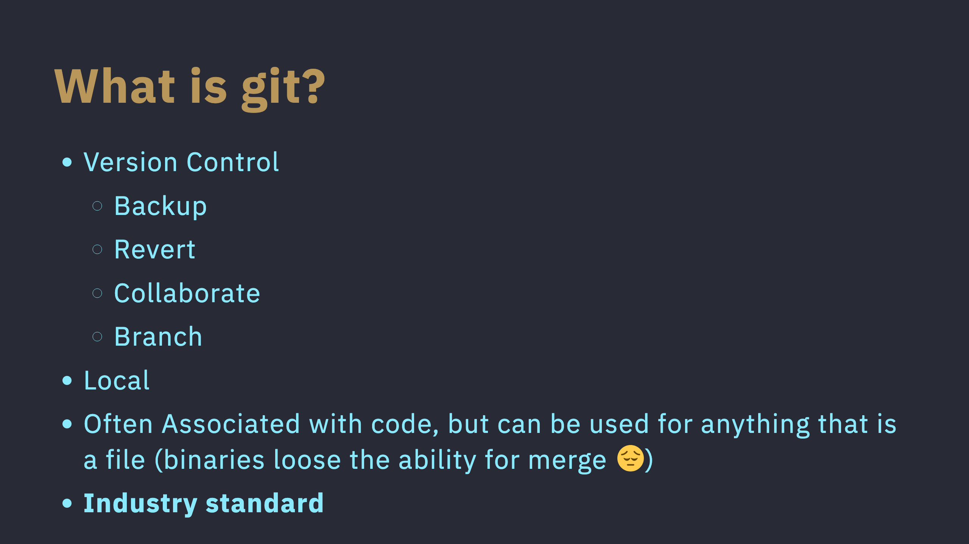
Notes:
## Agenda <div class="columns"><div> - What is git - What is github - Goals - Create a GitHub account - Downlod Github desktop - Create a repo - Add / Commit - Push / Pull </div><div> - Clone This Repo - Make a branch - Add a file - Make a Commit - Push - Create a Pull Request - Summary and additional tools </div></div>

Slide 4
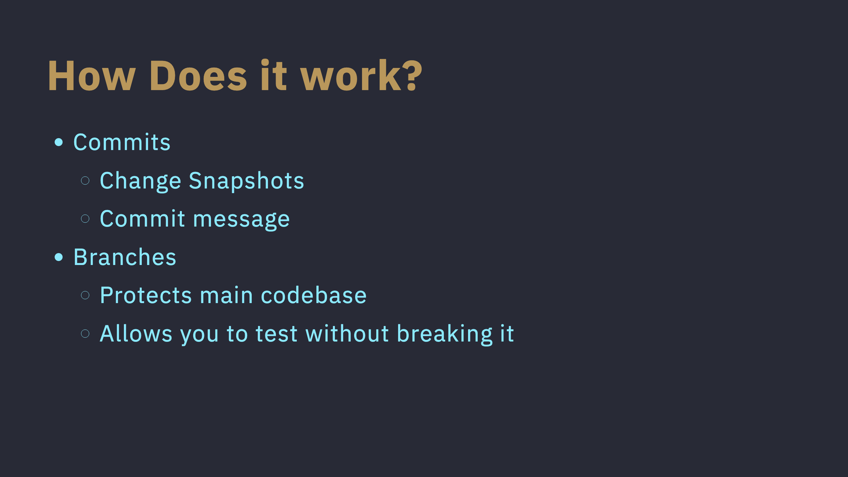
Notes:
In order to do those things, Git splits your work into something called a "commit" you can think of a commit as a snapshot of the changes you made since the last commit you want your commits to be small, and you commit messages to be descriptive so you know when you did what (in case you need to revert) git also has a concept called branches, you can visualize git commits like a tree, which is why they are called branches Generally, all new code goes on a branch until it works and then it is merged in.

Slide 5
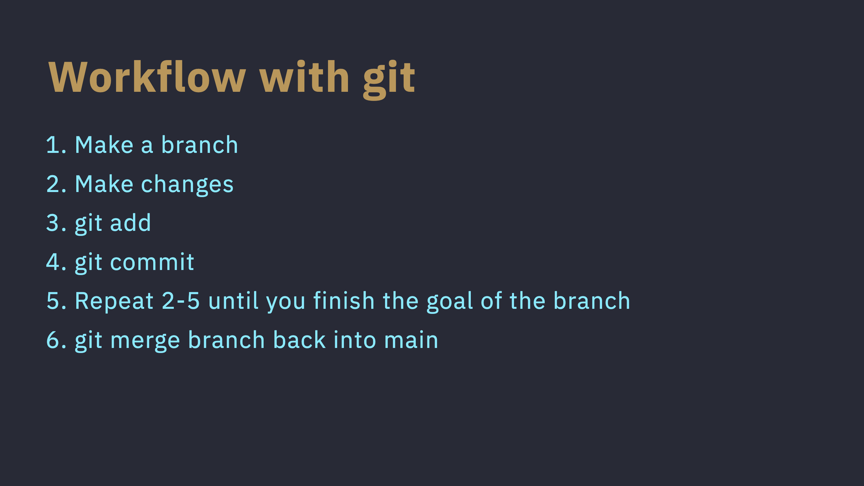

Slide 6
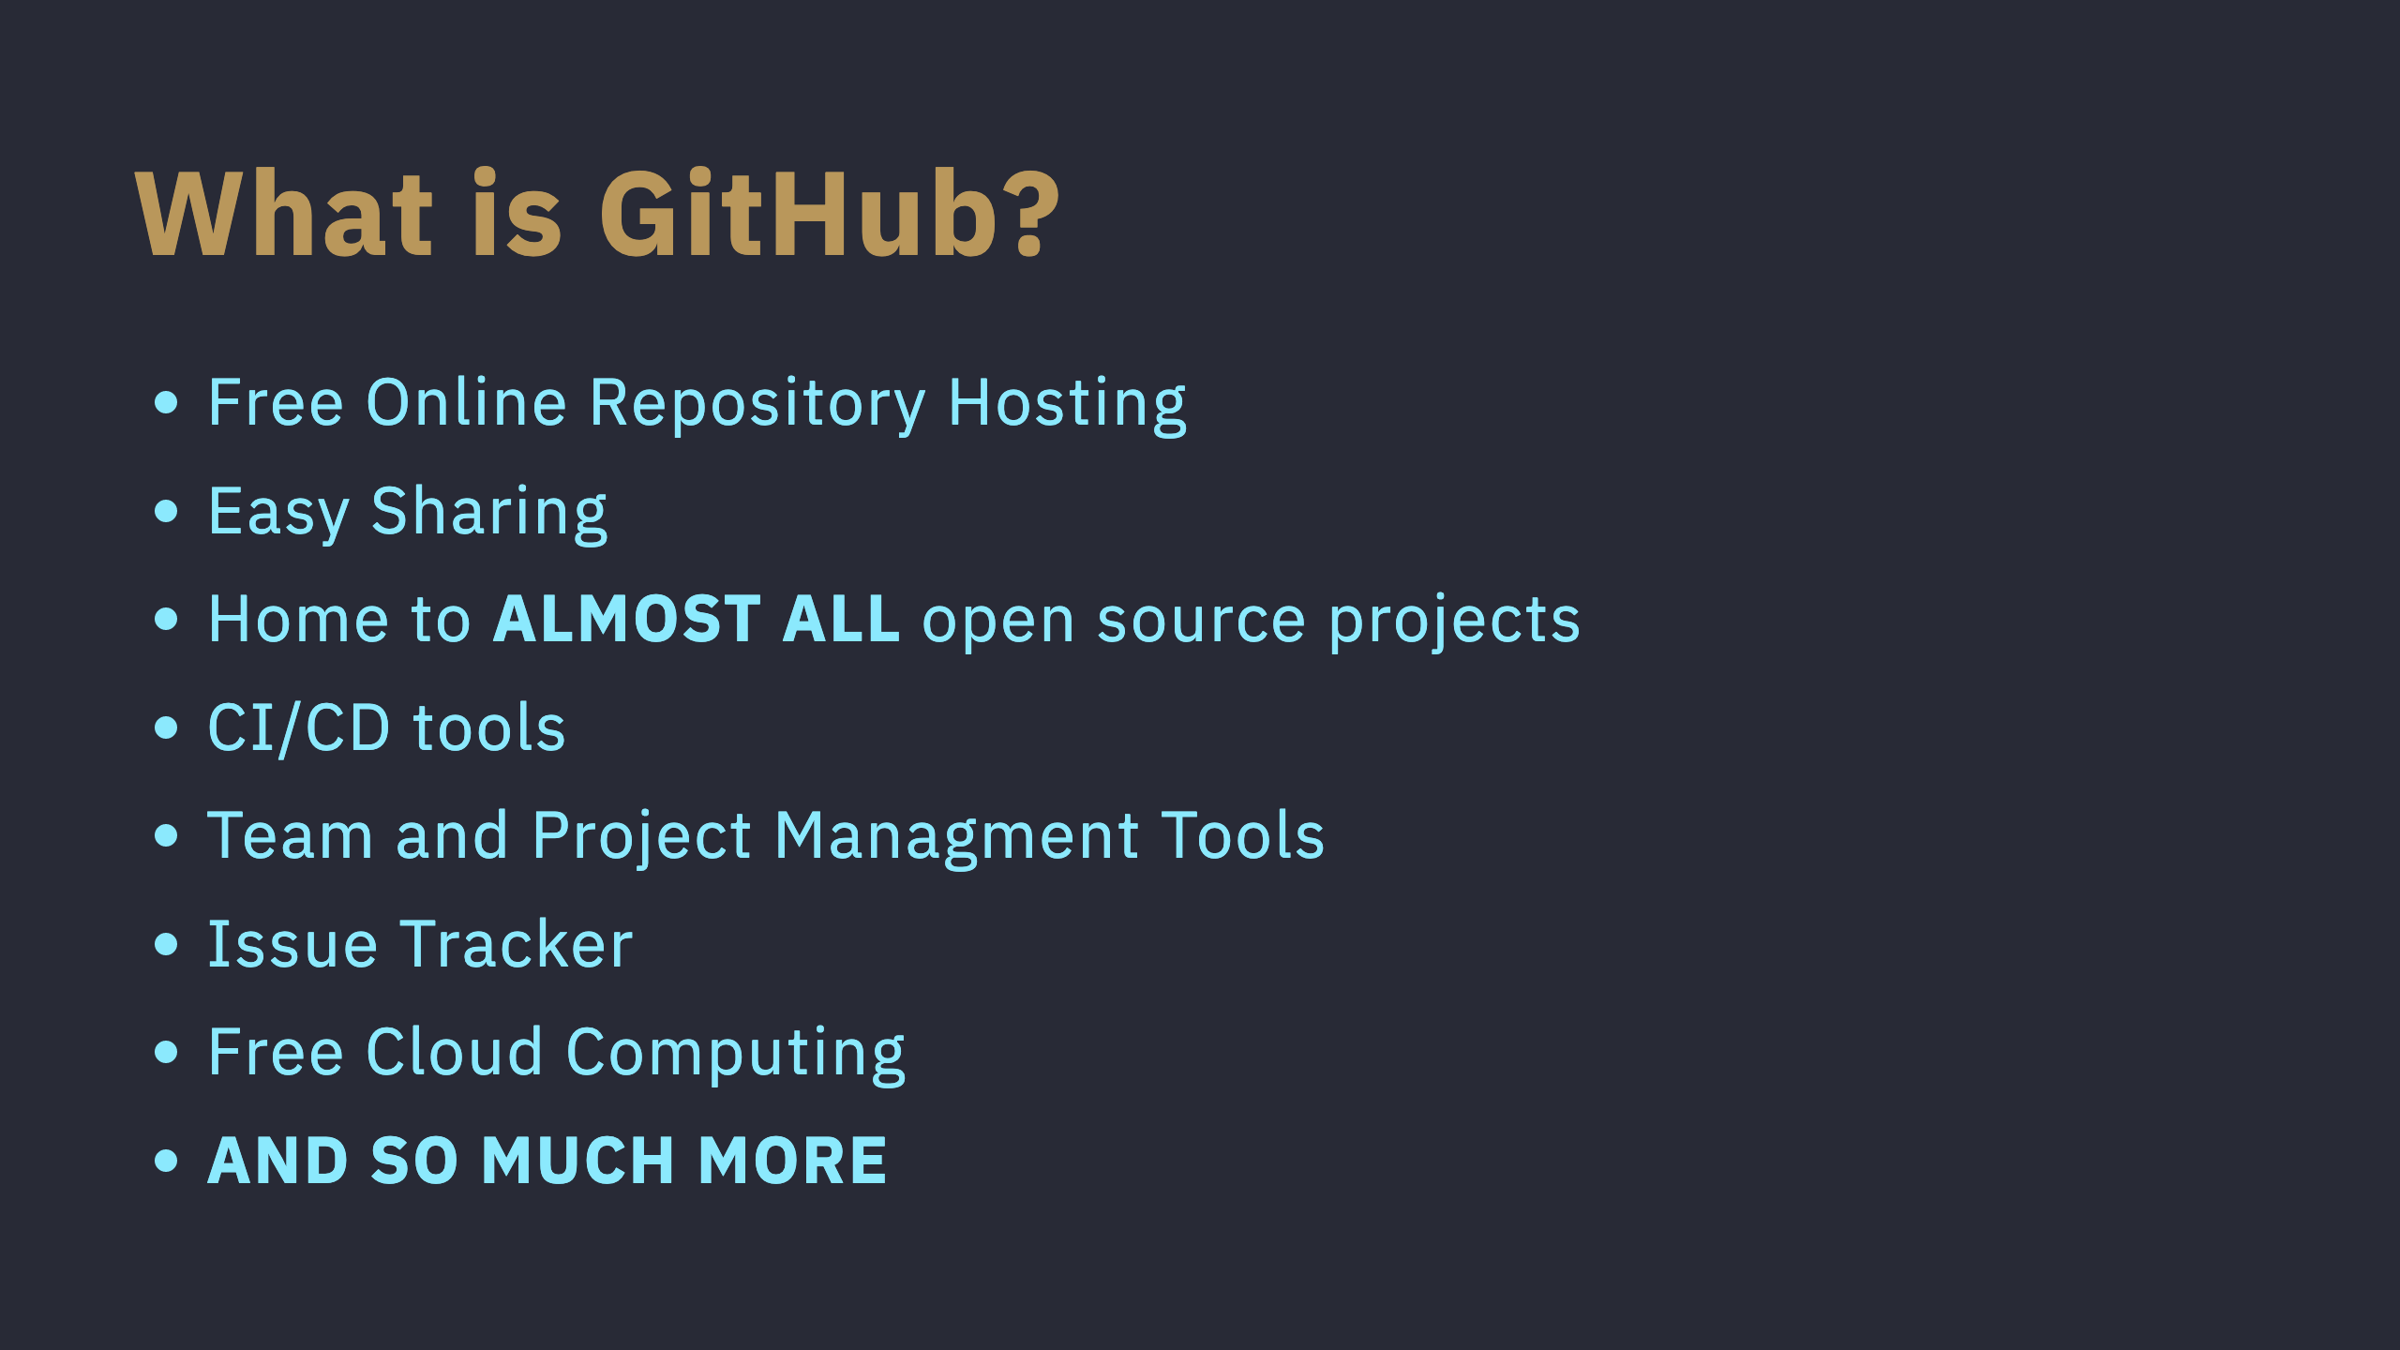

Slide 7
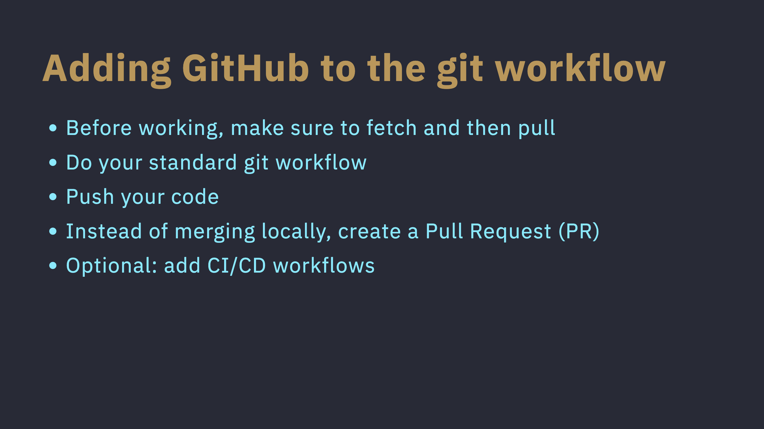

Slide 8


Slide 9


Slide 10
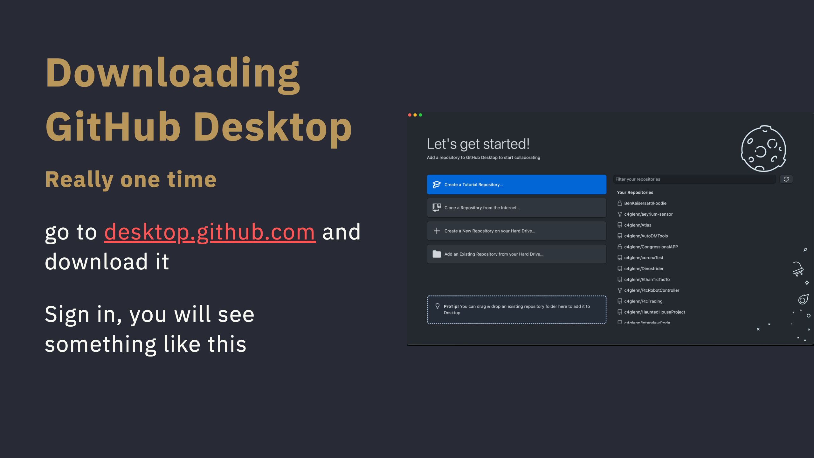

Slide 11
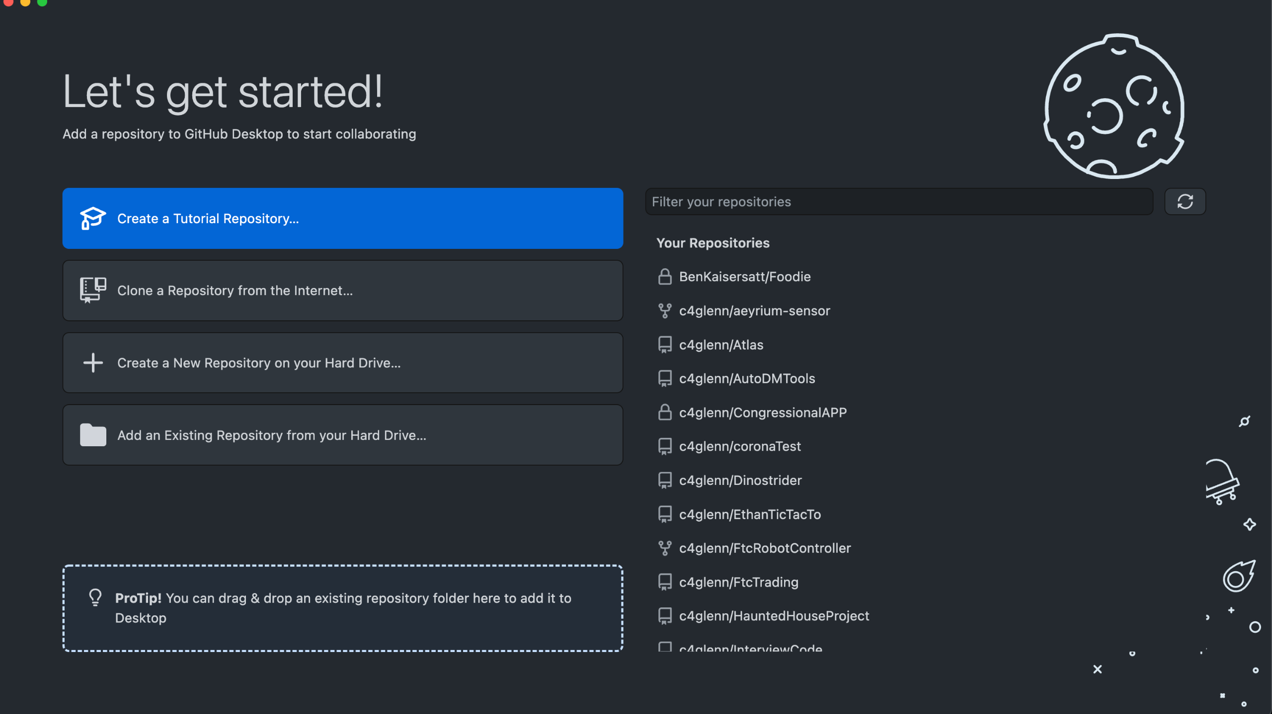
Notes:
speaker notes: the tutorial repository is great whenever you need a refresher Lets go ahead and Click Create a new Repository on your hard Drive

Slide 12
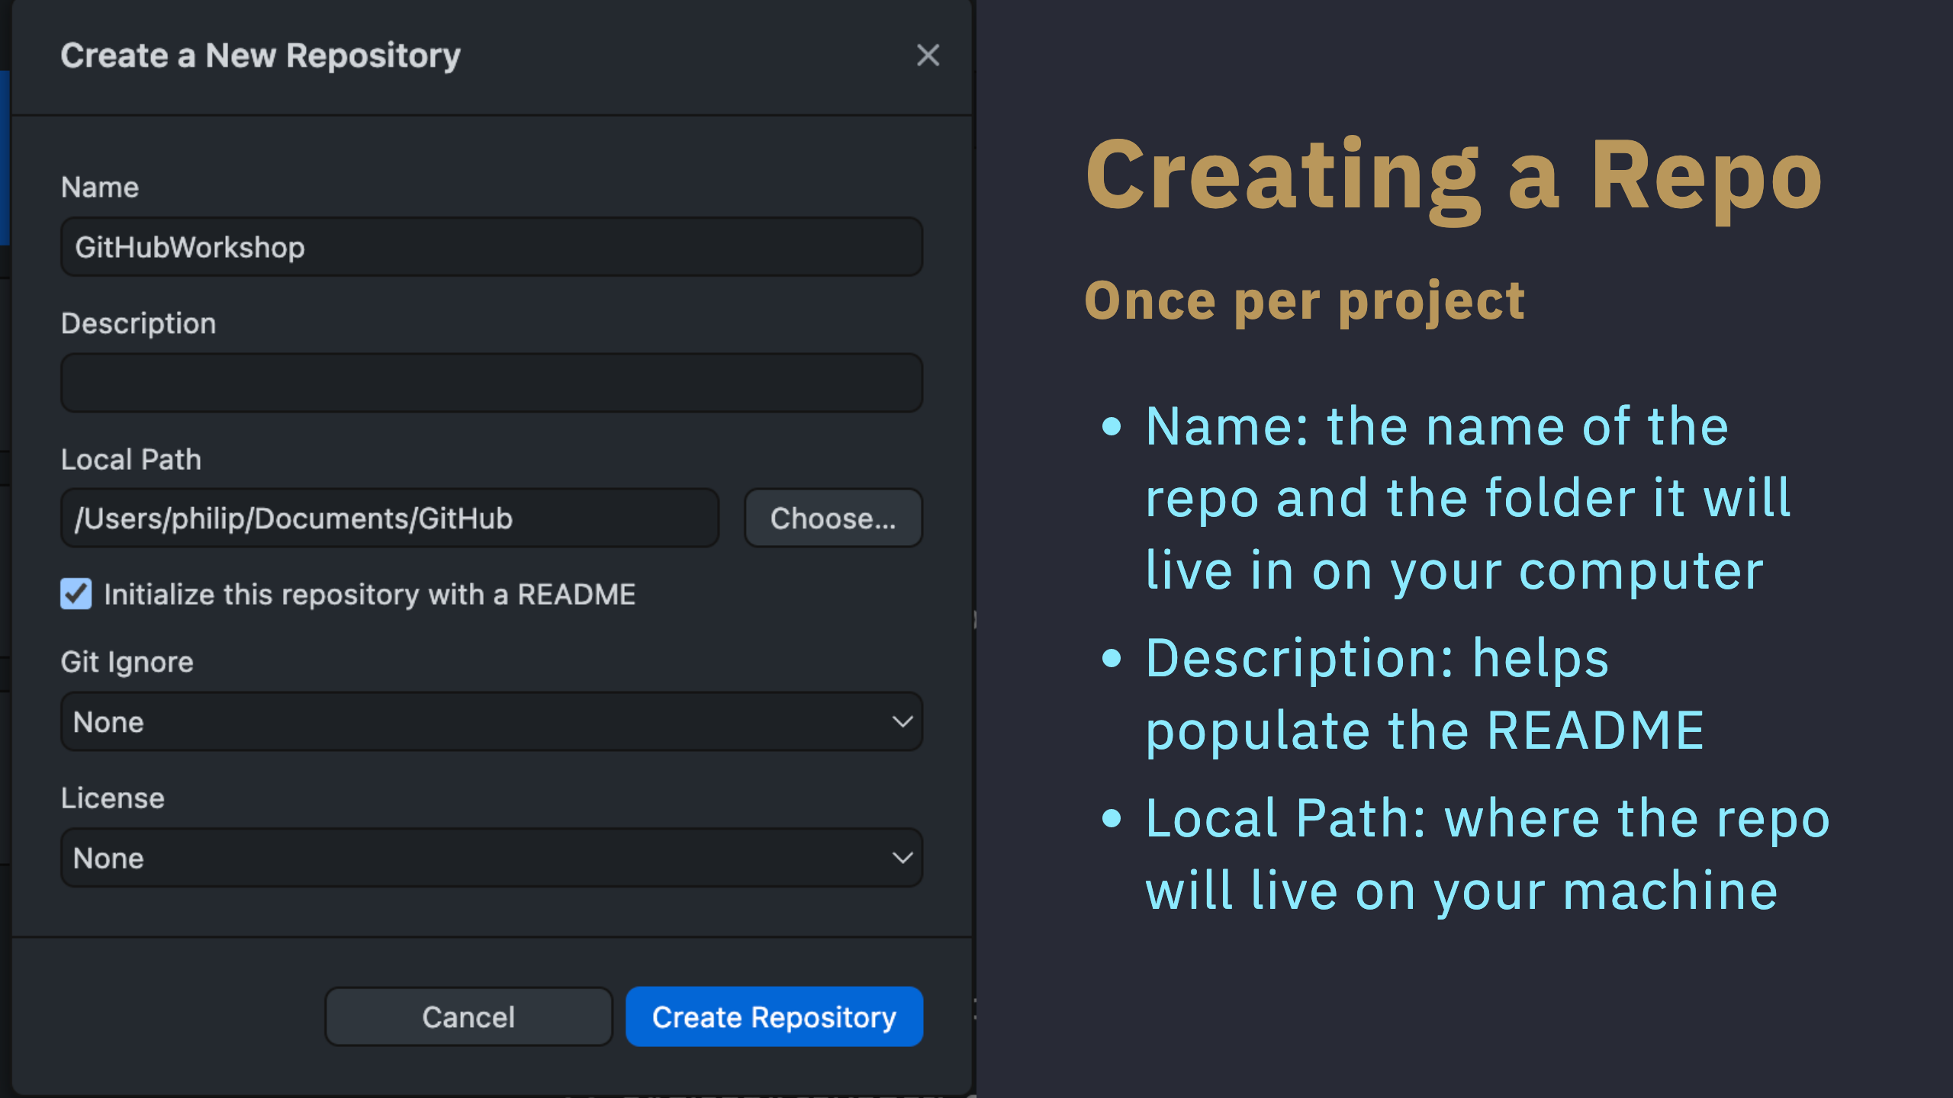

Slide 13
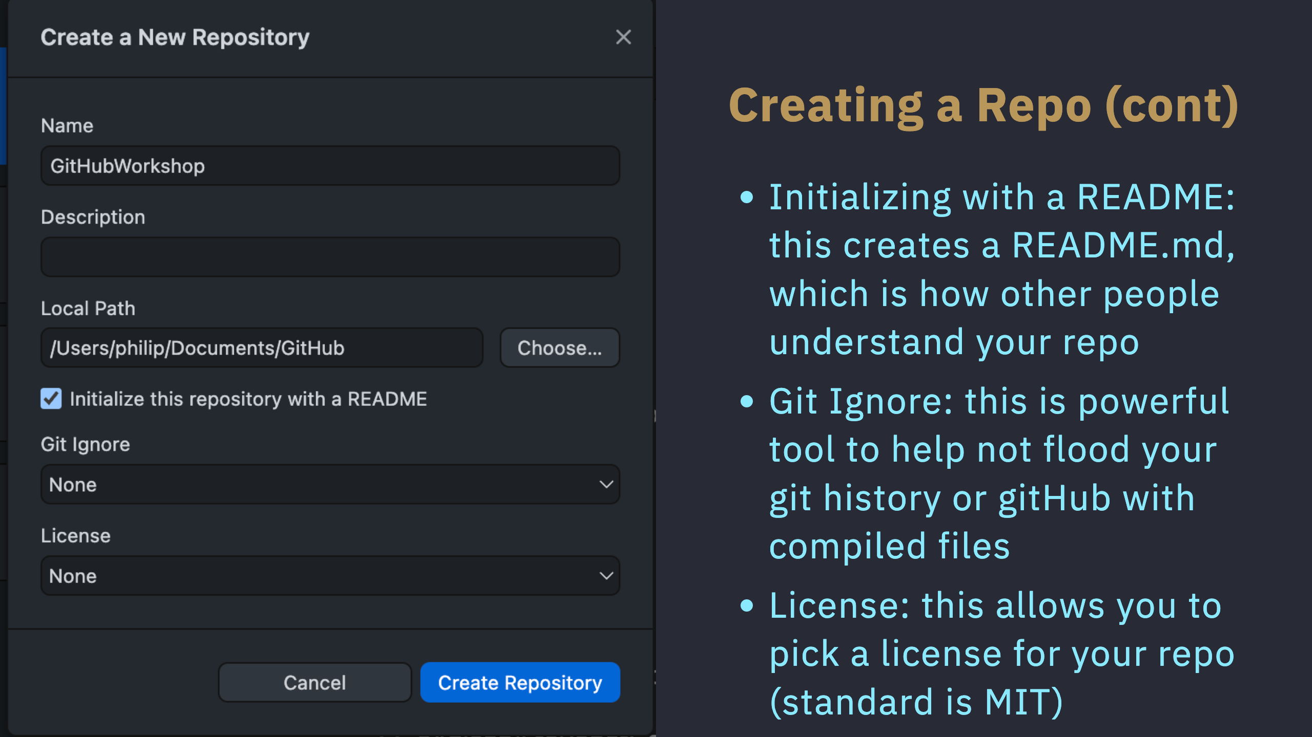

Slide 14
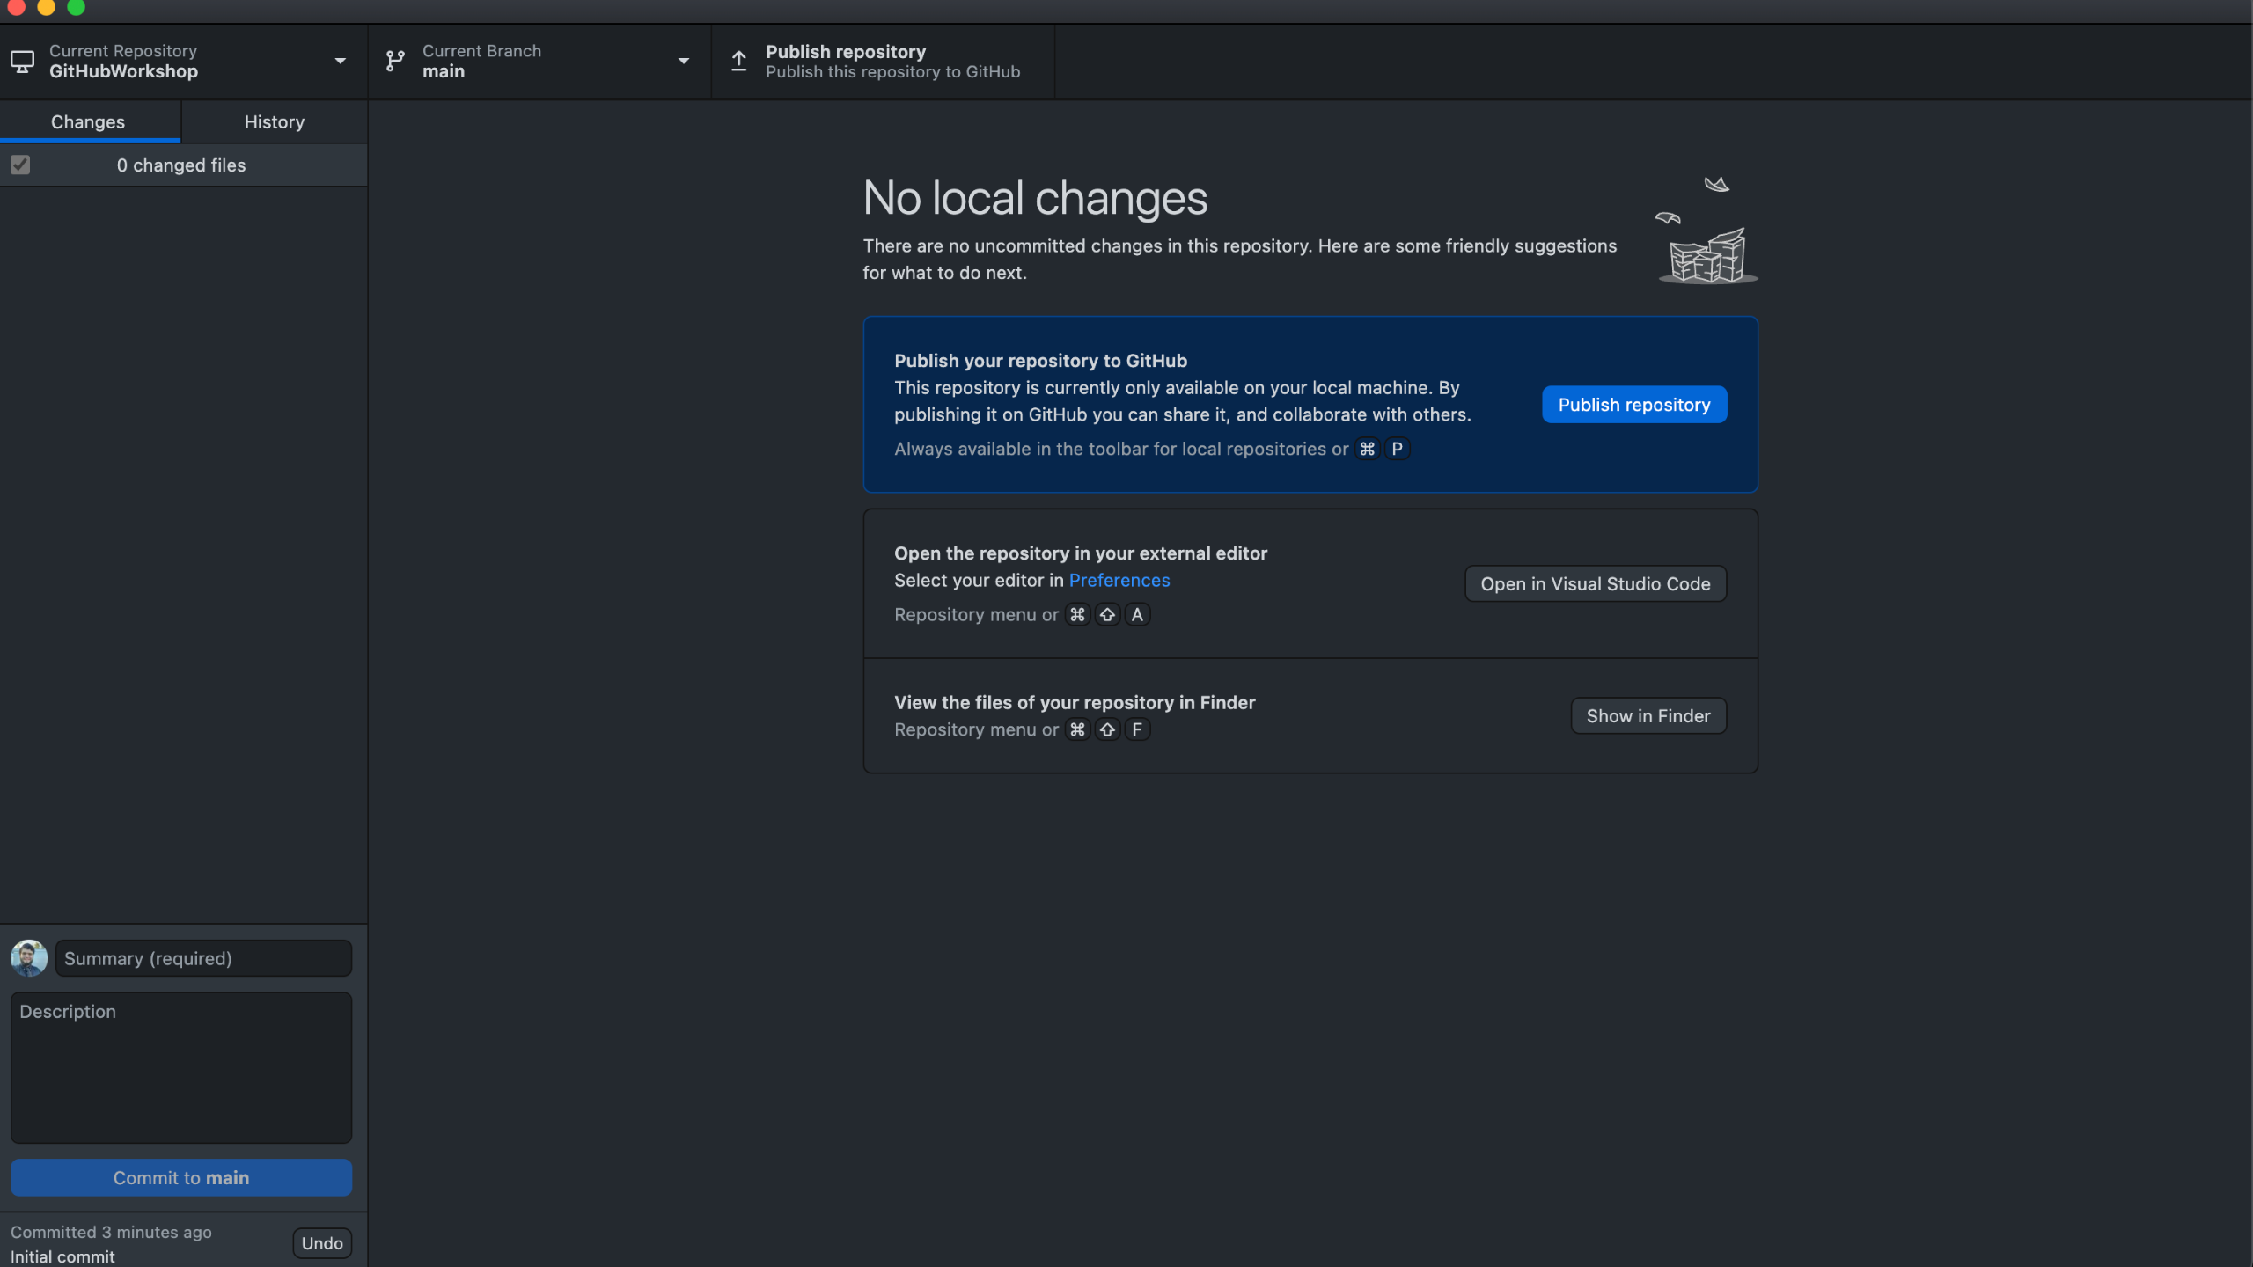
Notes:
The defualt view of github desktop, go ahead and hit publish repo, or CMD/CTRL P

Slide 15
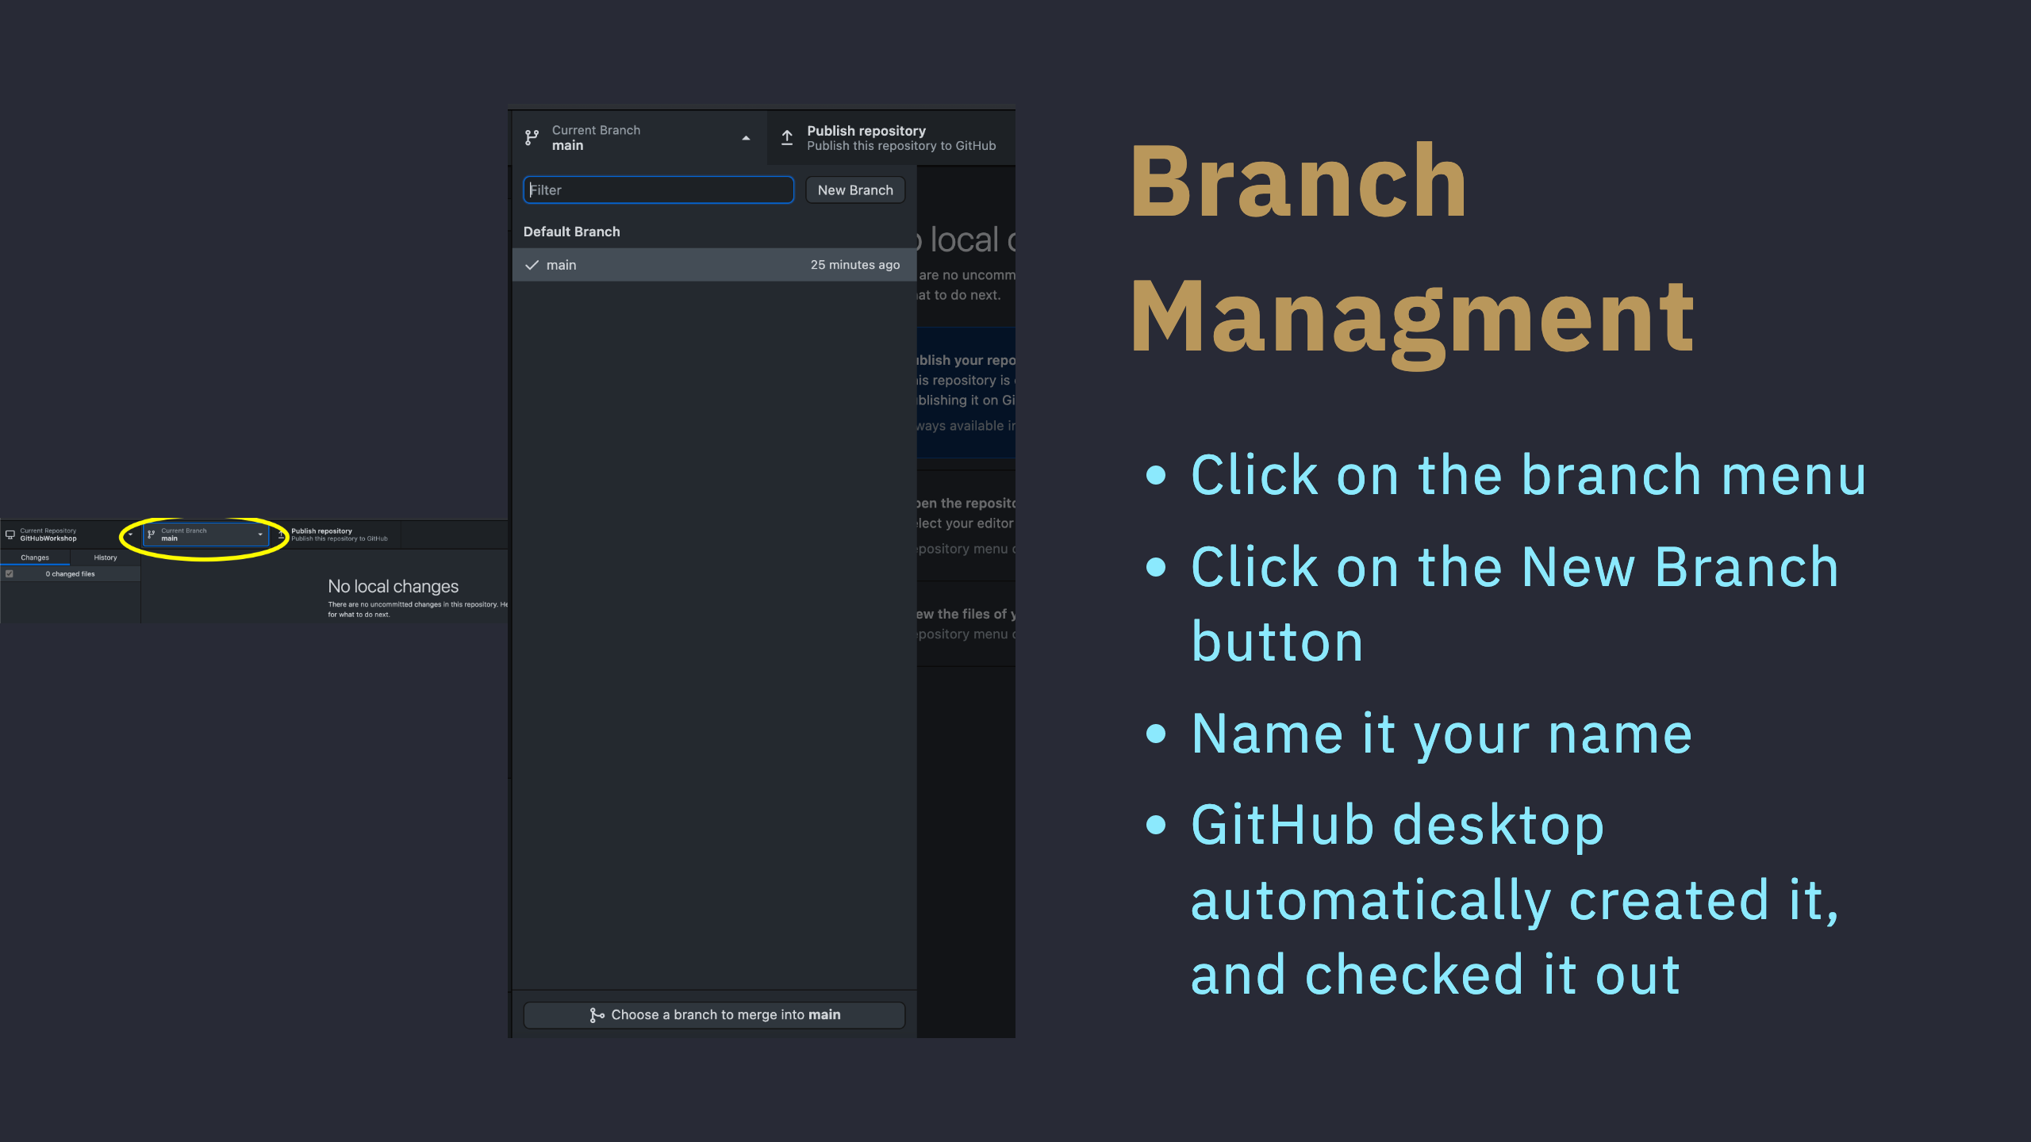

Slide 16
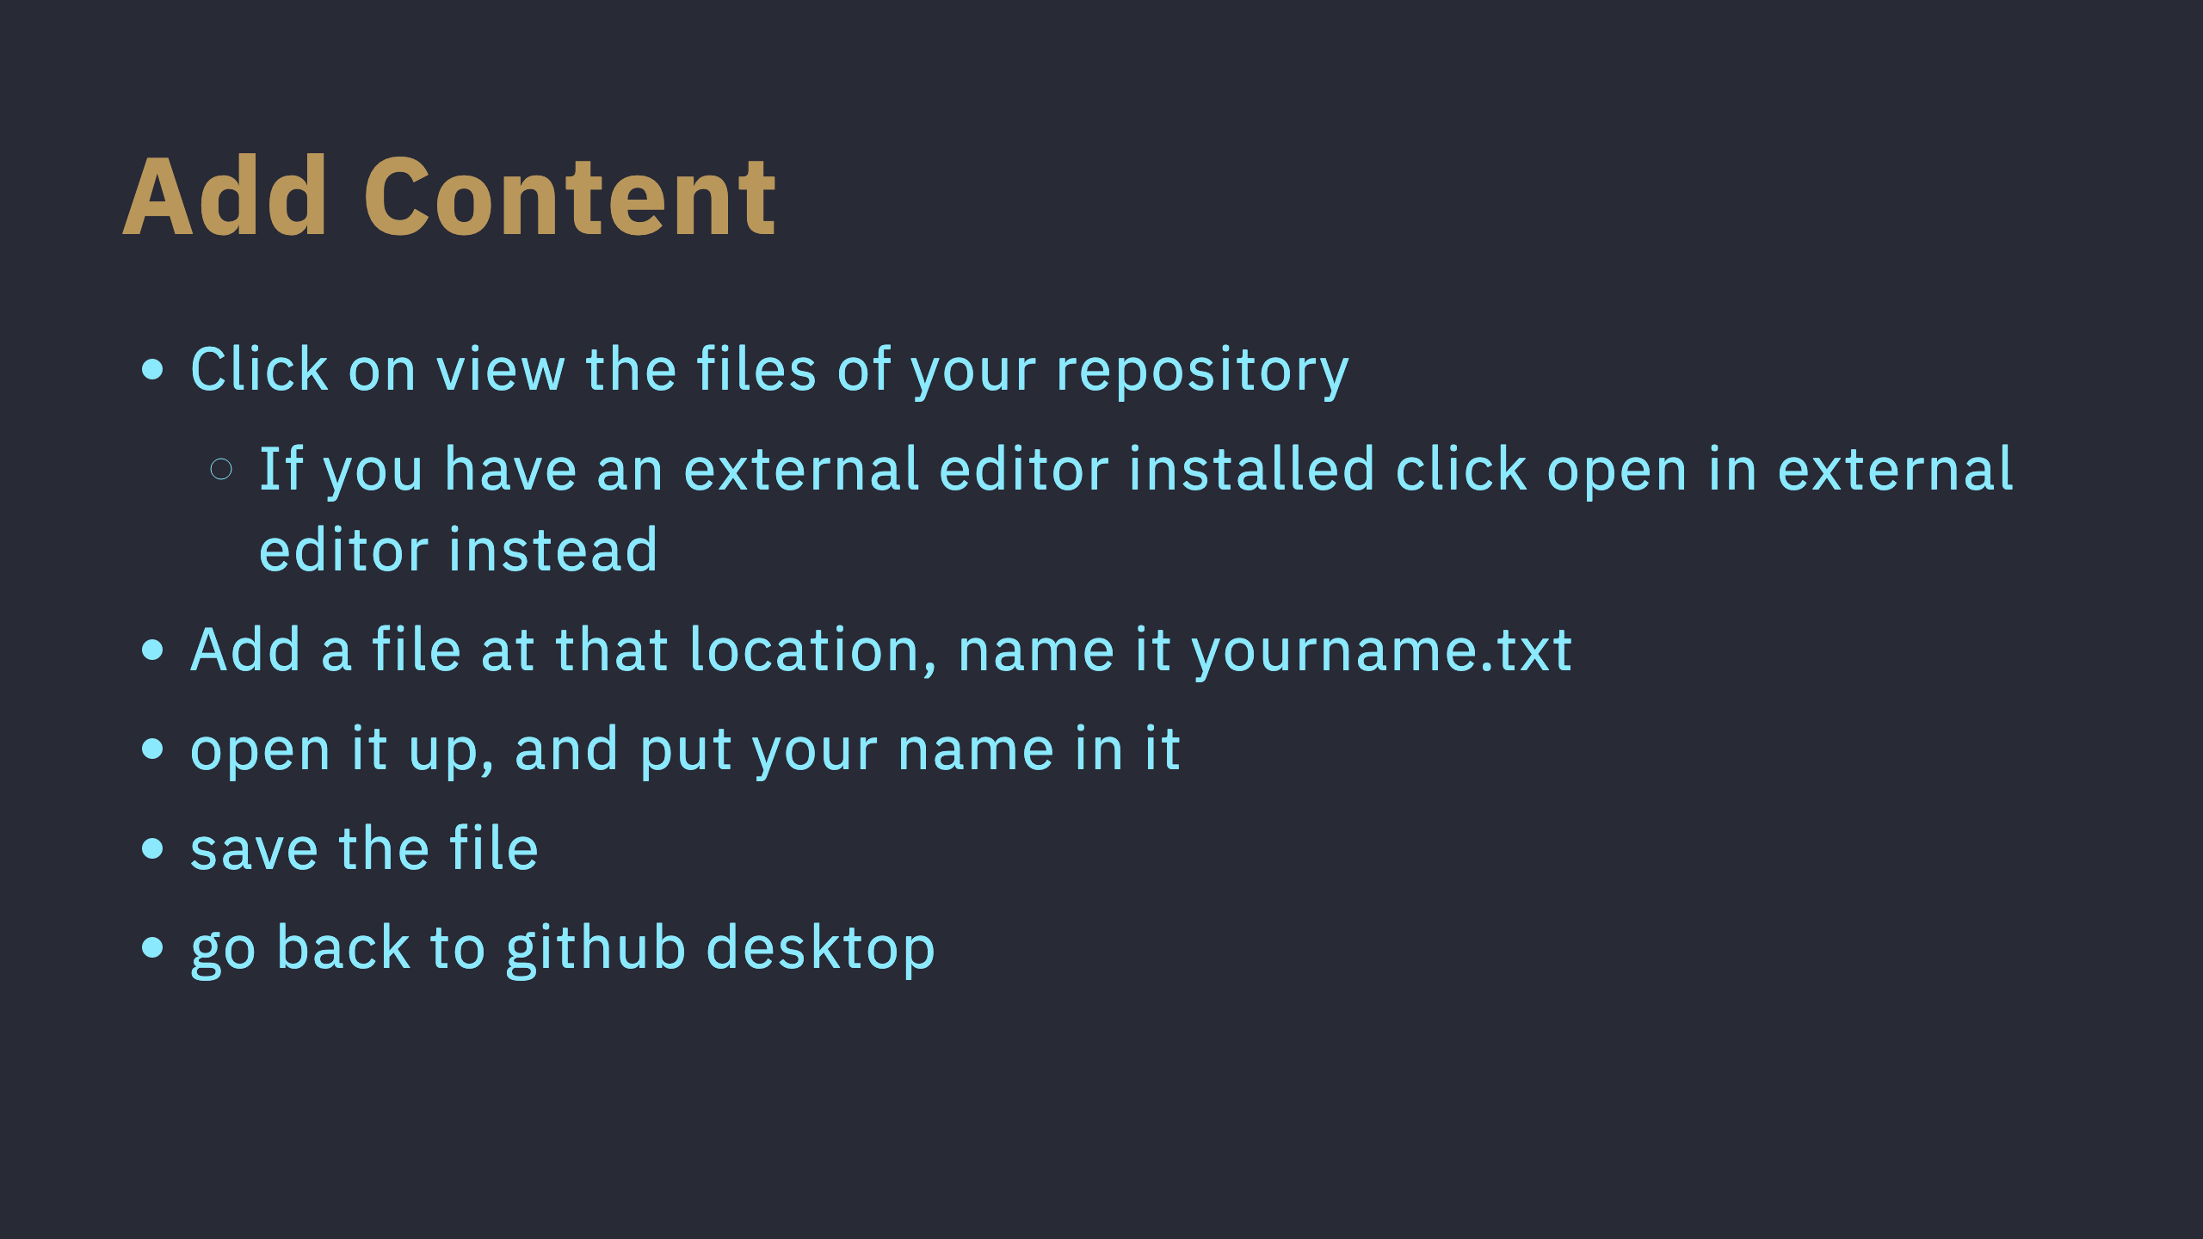

Slide 17
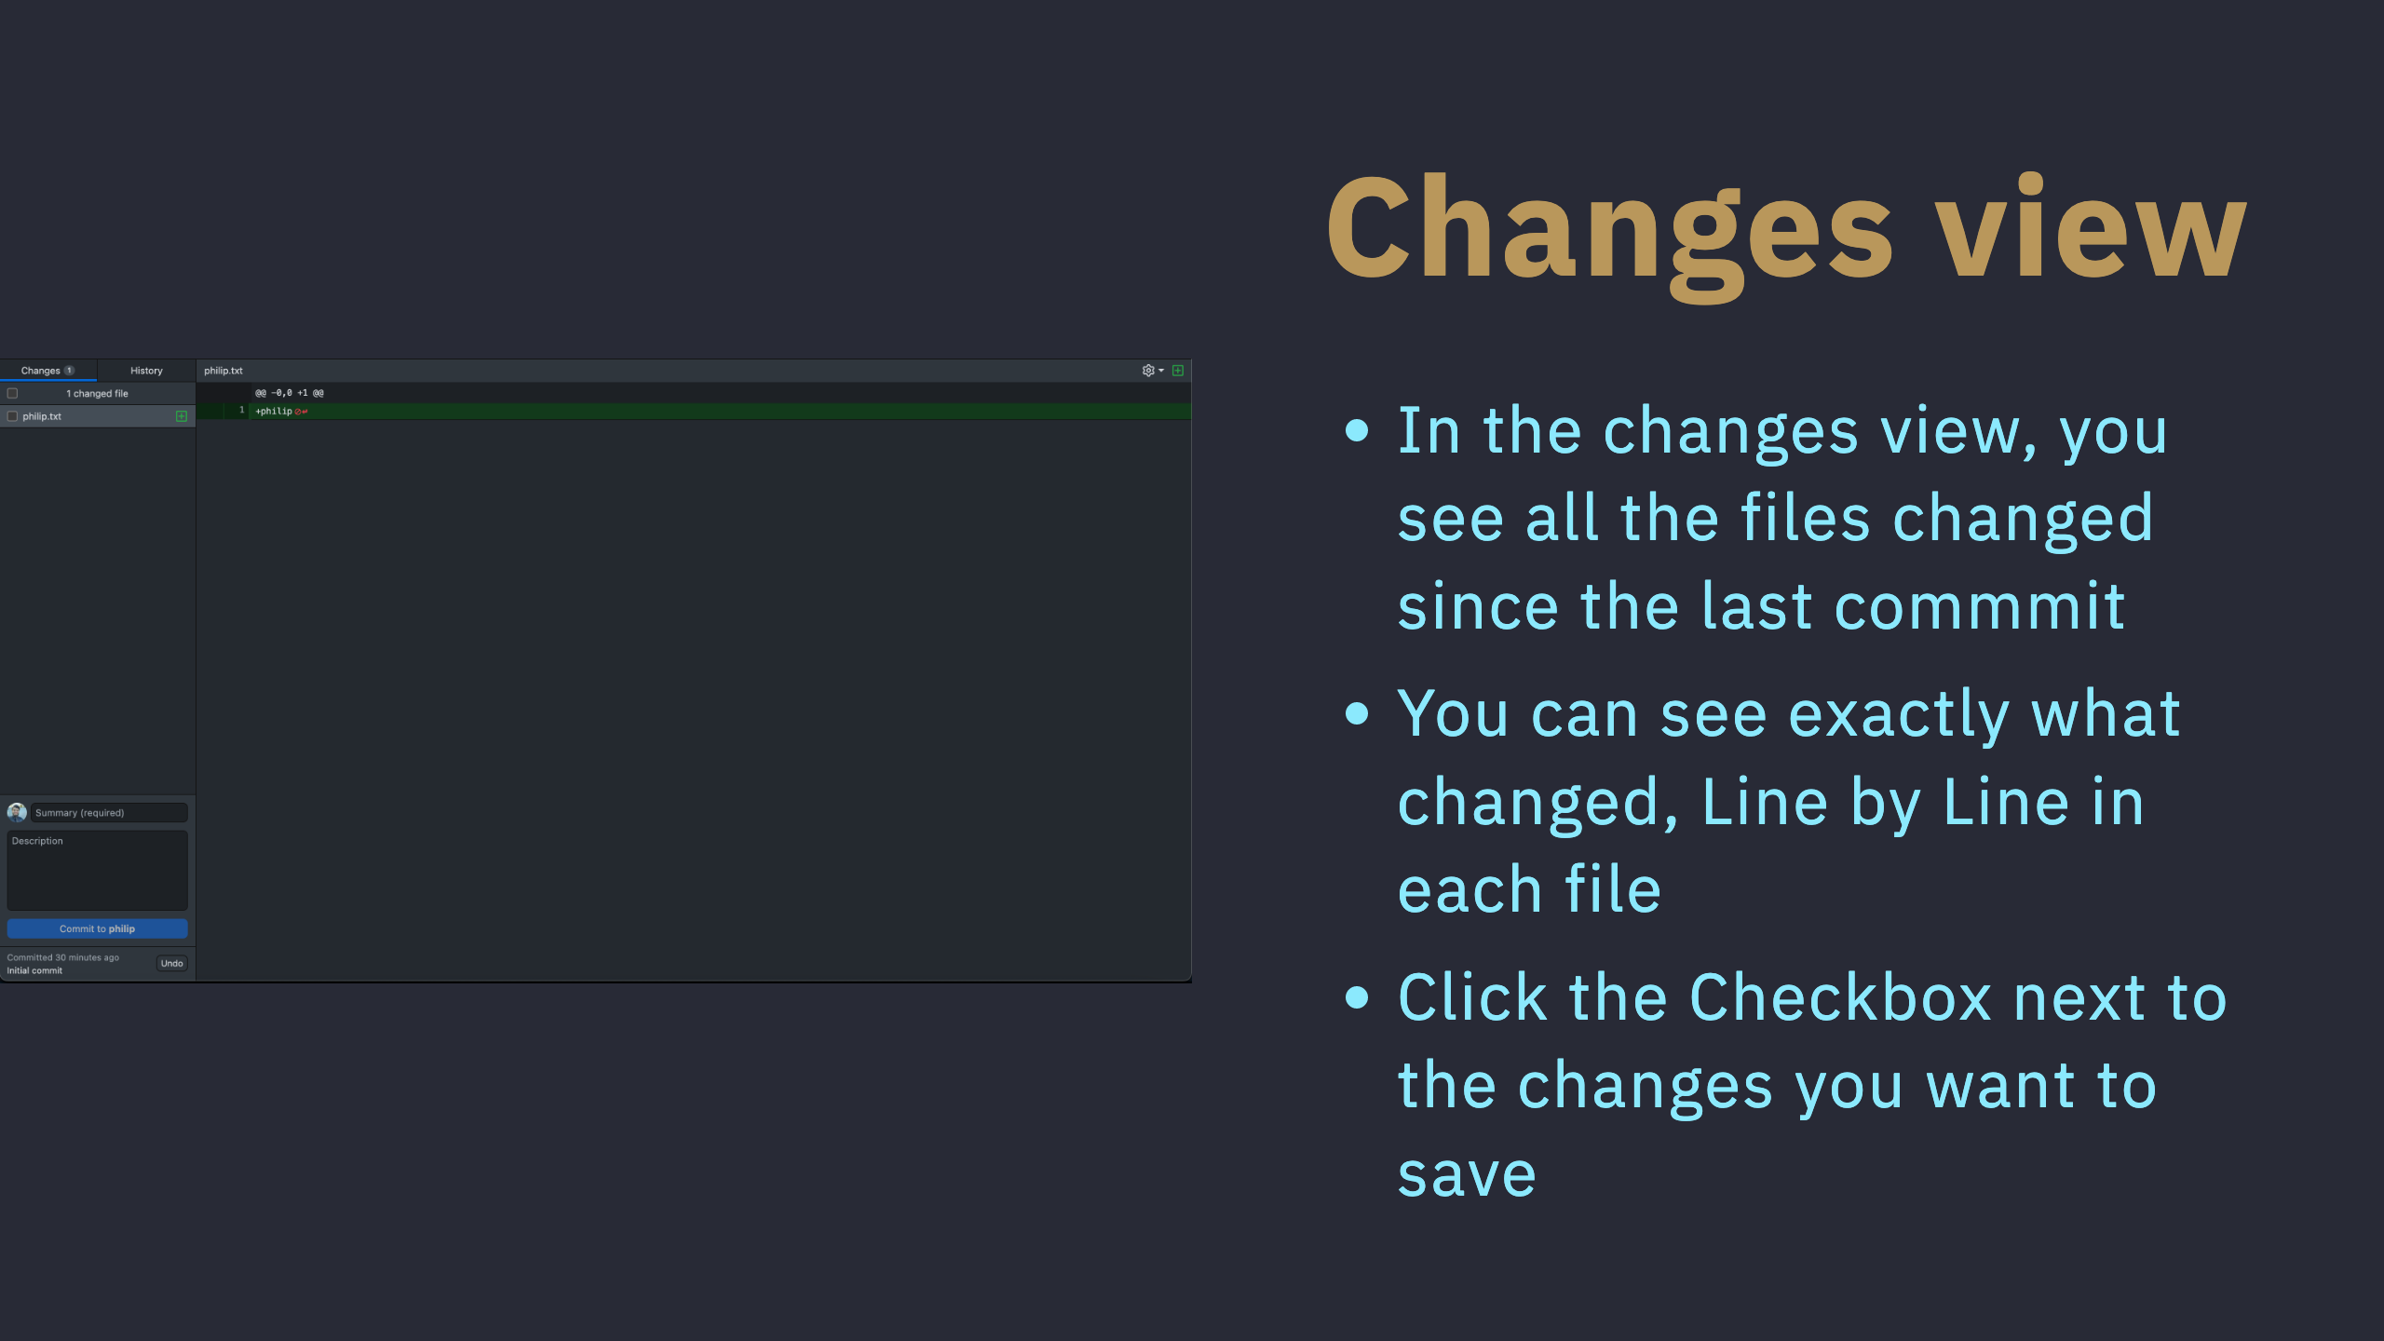

Slide 18
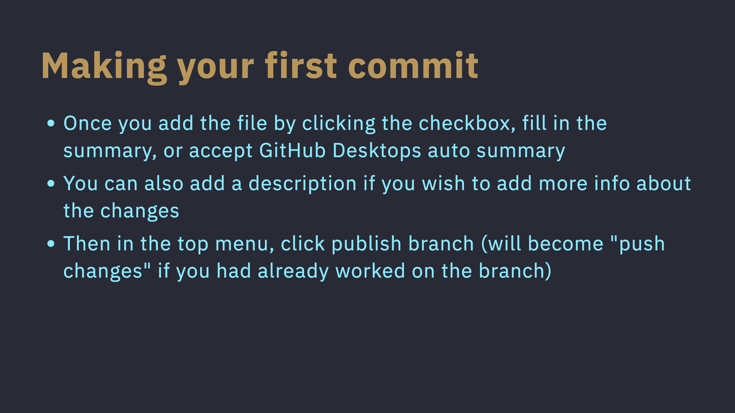

Slide 19
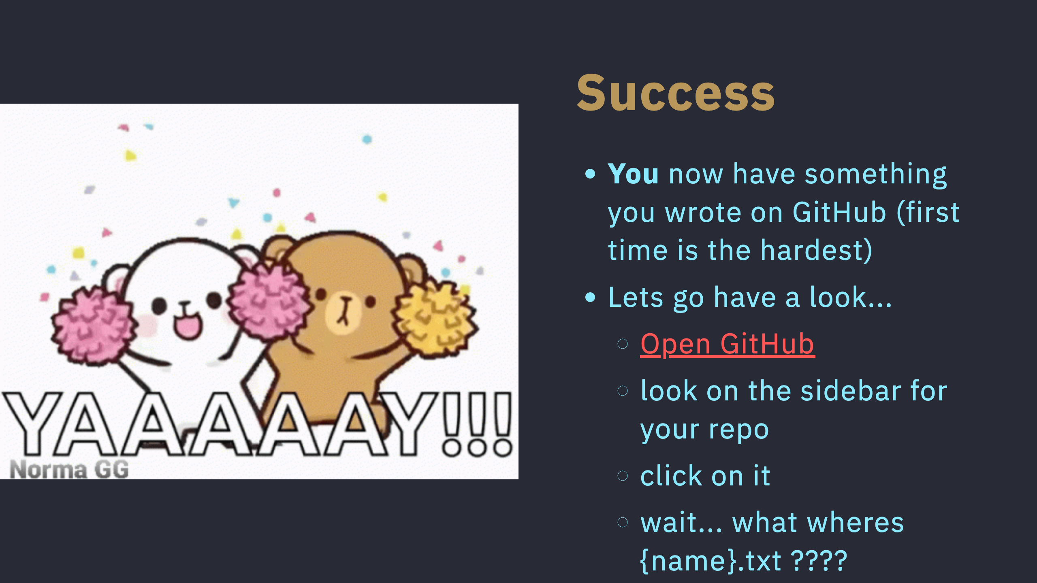

Slide 20
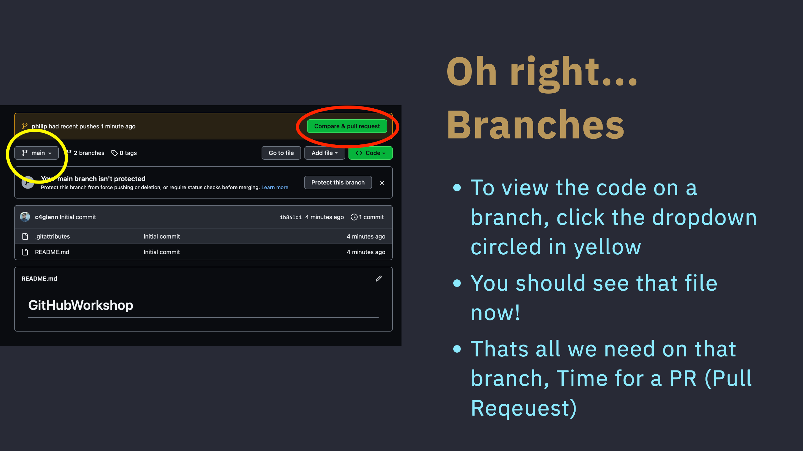

Slide 21
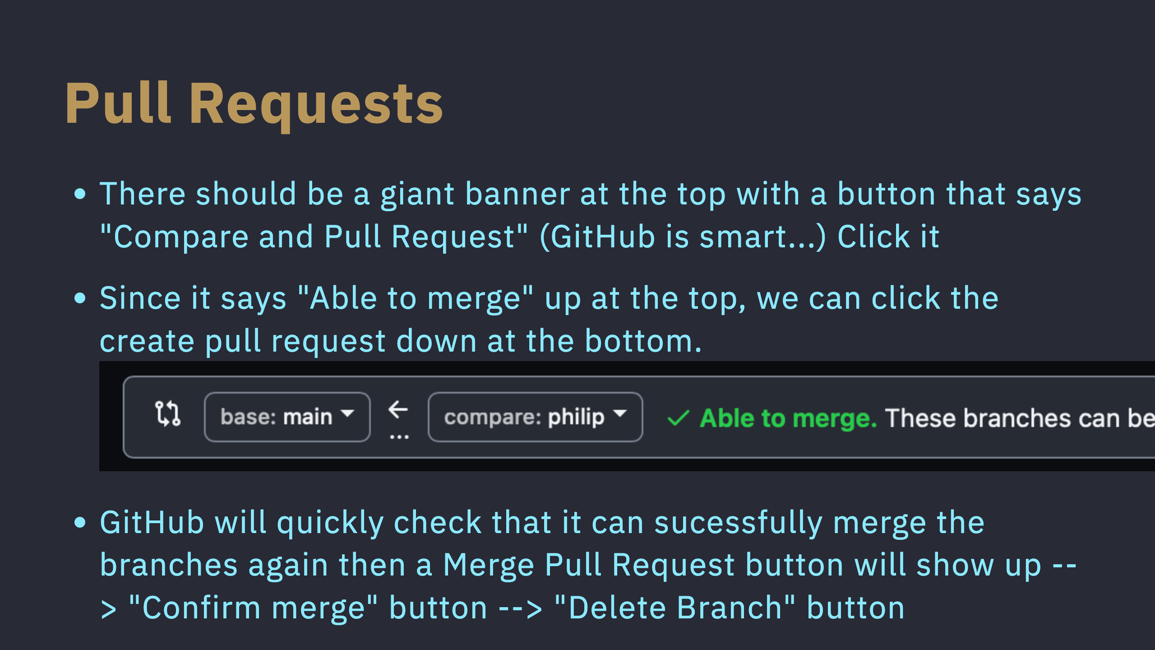

Slide 22
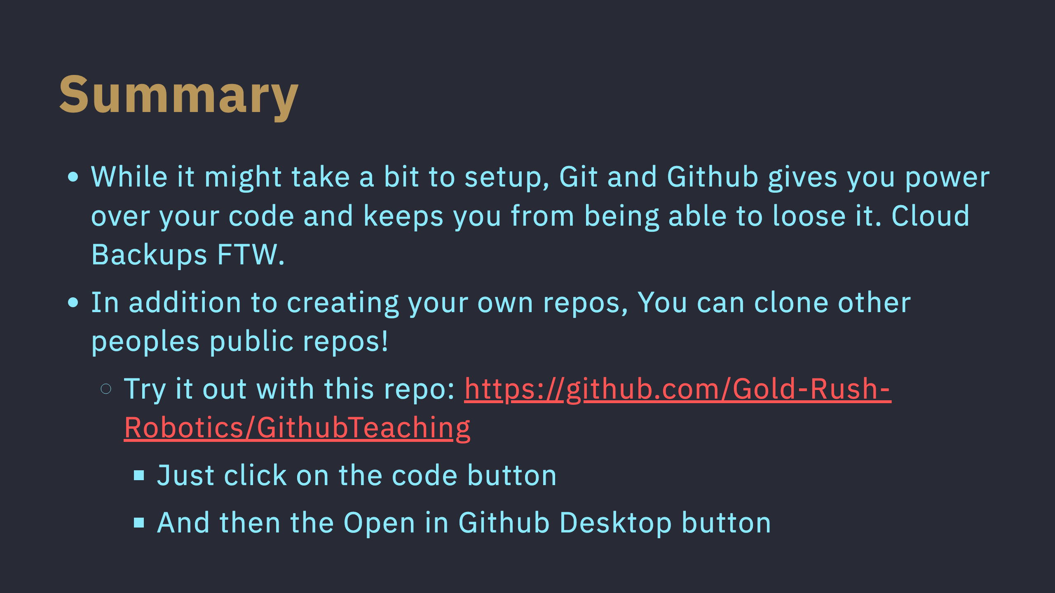

Slide 23
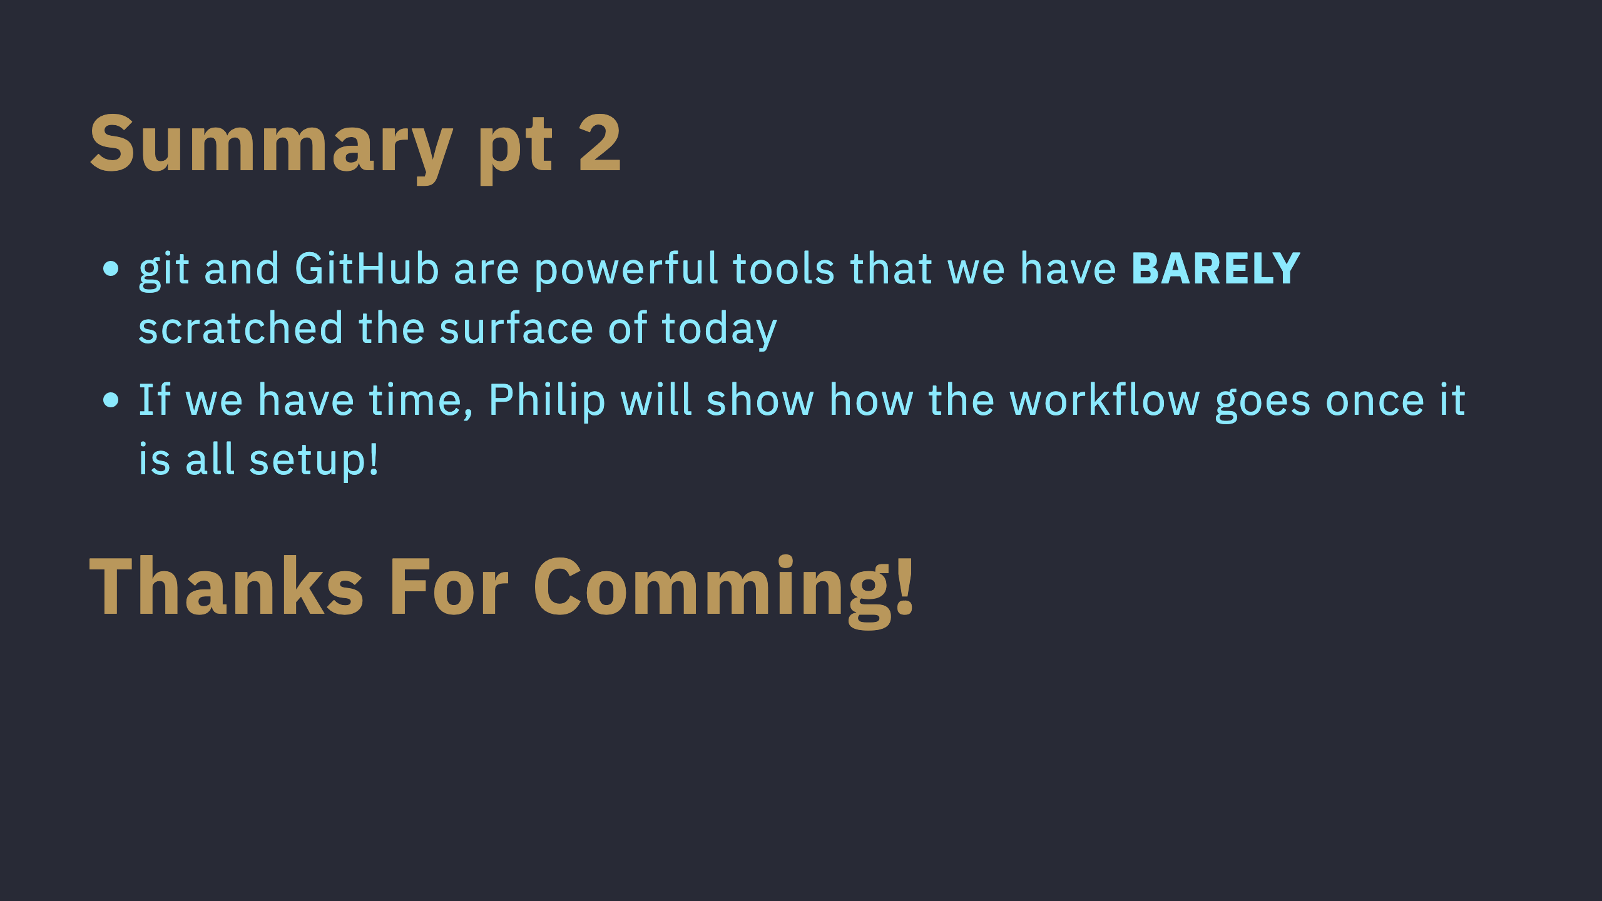

Slide 24
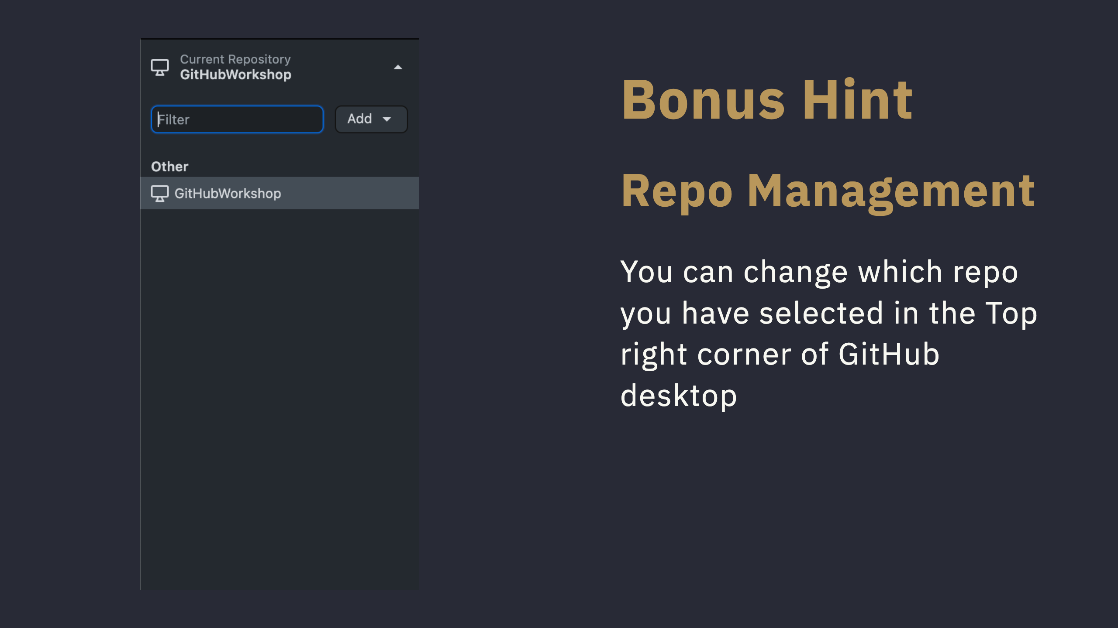
Notes:
If you click back on code, you should see the file on the main branch!

Slide 25


